Slide 1

RFID Based Smart School
Project Guide : Prof. Jagtap K.. G.

Slide 2





Outline of talk
01
02
03
04
05
06
Introduction & Technologies Used
Problem Statement
Block Diagram
Component used
Result
Conclusion
References
06

Slide 3
Problem Statement
Design and develop an RFID-based Smart School System to enhance the security, efficiency, and management of students and staff within a school environment. The system should address the following key challenges and requirements:
Student and staff attendance tracking
Child safety

Slide 4
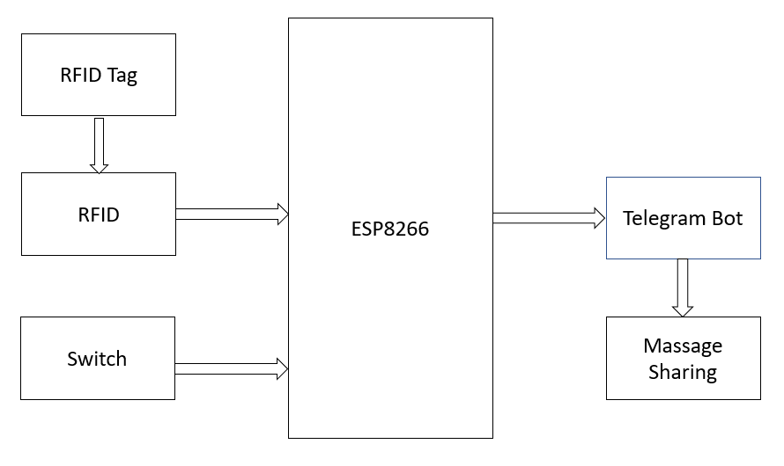
Block Diagram of Bus Unit

Slide 5
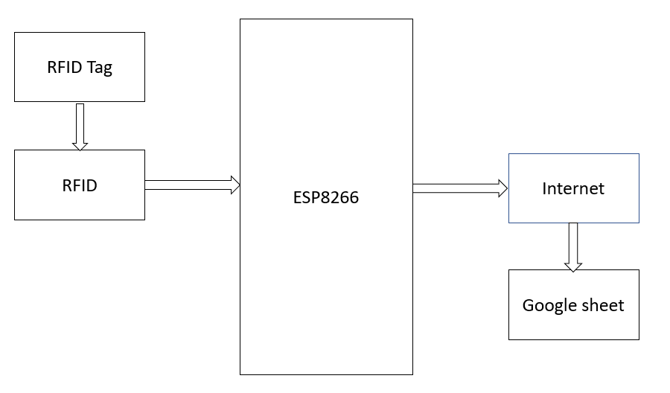
Block Diagram of School Unit

Slide 6
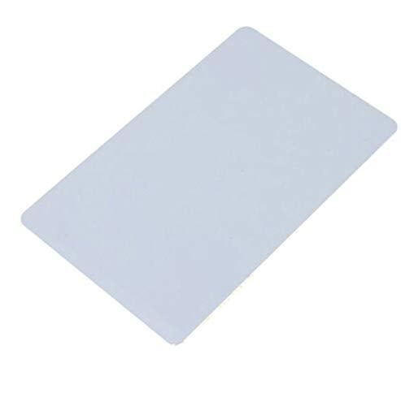
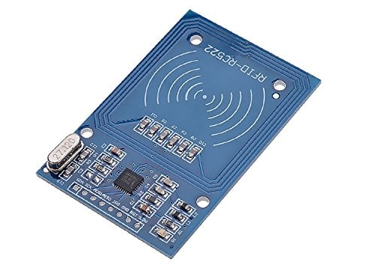
Components used
RFID card
RFID reader

Slide 7
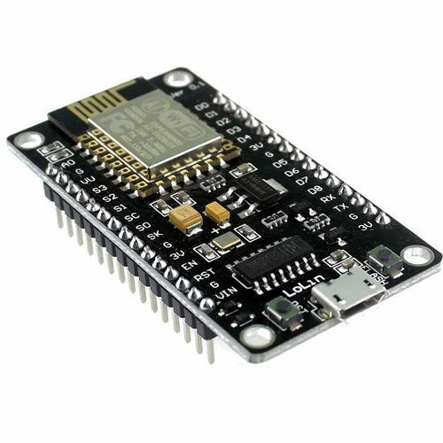
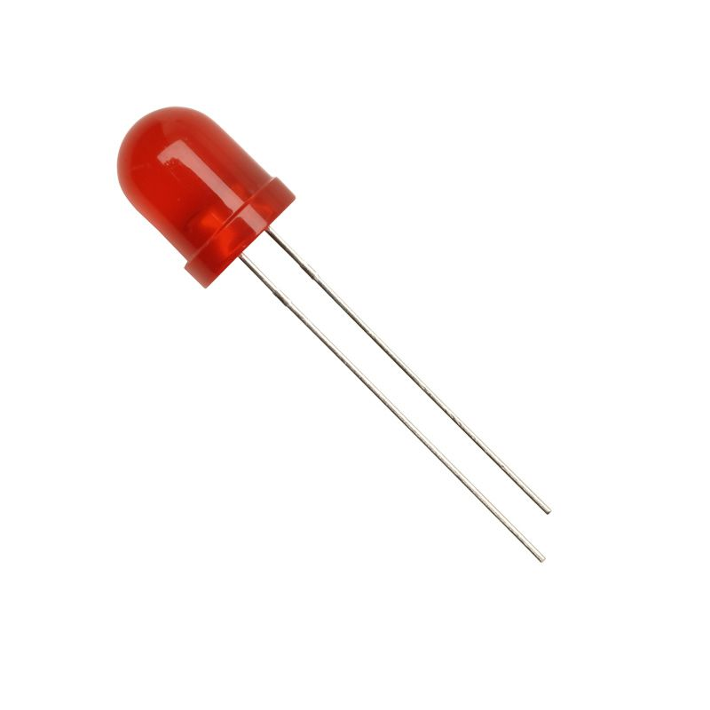
Components used
Node MCU
LED

Slide 8
Objectives
Efficient attendance tracking
Student safety
Parental communication
Reduced paper work
Emergency response

Slide 9
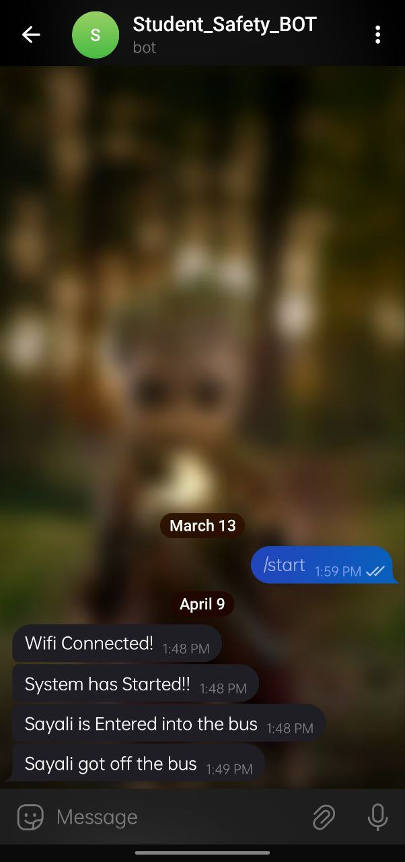
Result

Slide 10
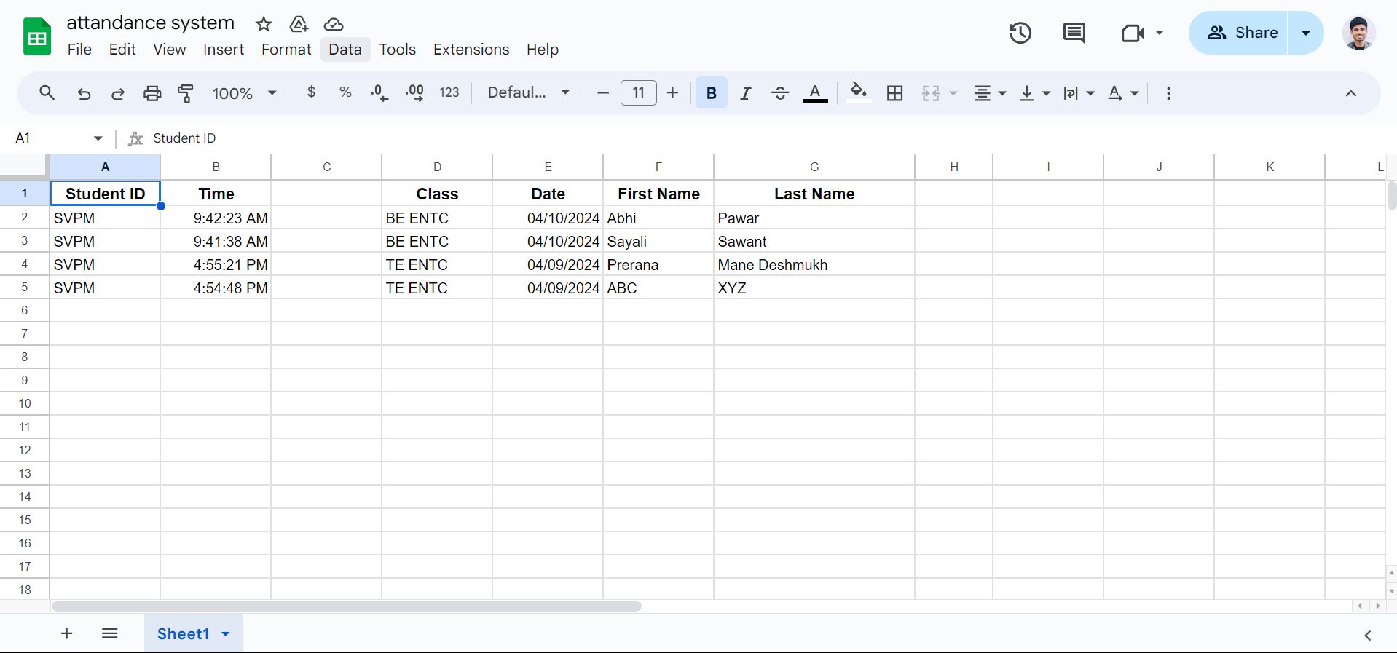
Result

Slide 11
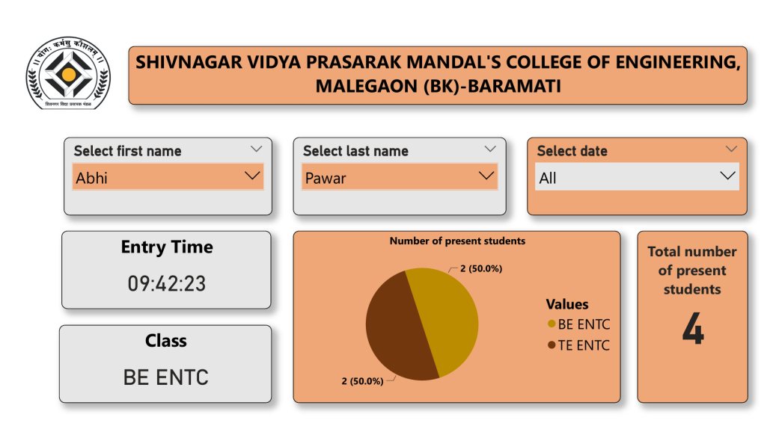
Result

Slide 12
Conclusion
Parent-Teacher Communication: RFID-based systems can be used to automate parent-teacher communication by tracking students' movements and sending notifications to parents when their children arrive at or leave school.
Data Analysis: RFID systems generate a wealth of data that can be analyzed to gain insights into school operations.
Attendance Tracking: RFID tags or cards can be used to track student attendance automatically.

Slide 13
References
Mohd. Firdaus Bin Mahyidin. “Student Attendance Using RFID System”. in University Malaysia, Pahang, May2008.
Herdawatie Abdul Kadir, Mohd Helmy Abd. Wahab, Zarina Tukiran, Ariffin Abdul Mutalib. “Tracking Student Movement using Active RFID”. in 9th WSEAS International Conference, ISSN : 1790-5117.

Slide 14
Thank You !

